Slide 1
14.11.2020
Physically based Rendering
Fabian Meister WS20/21
1

Slide 2
Agenda
Motivation
Reflectance equation
Codebeispiel
Live Demo
Zusammenfassung

Slide 3
Motivation

Slide 4
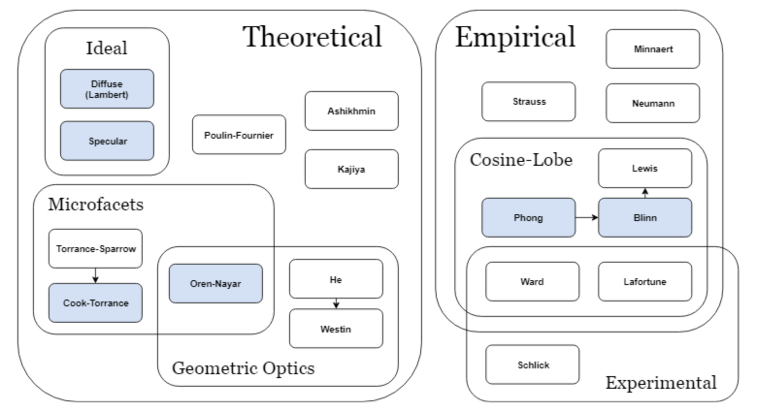
Modell Einordnung
[1]

Slide 5
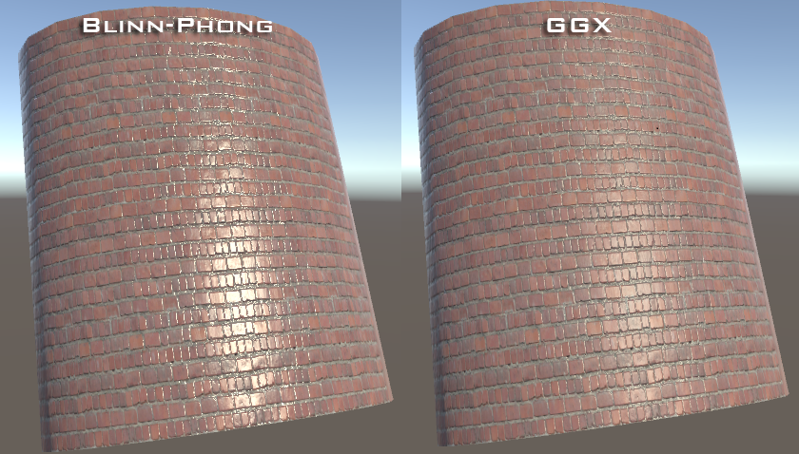
Vergleich Blinn Phong vs. Pbr
[2]

Slide 6
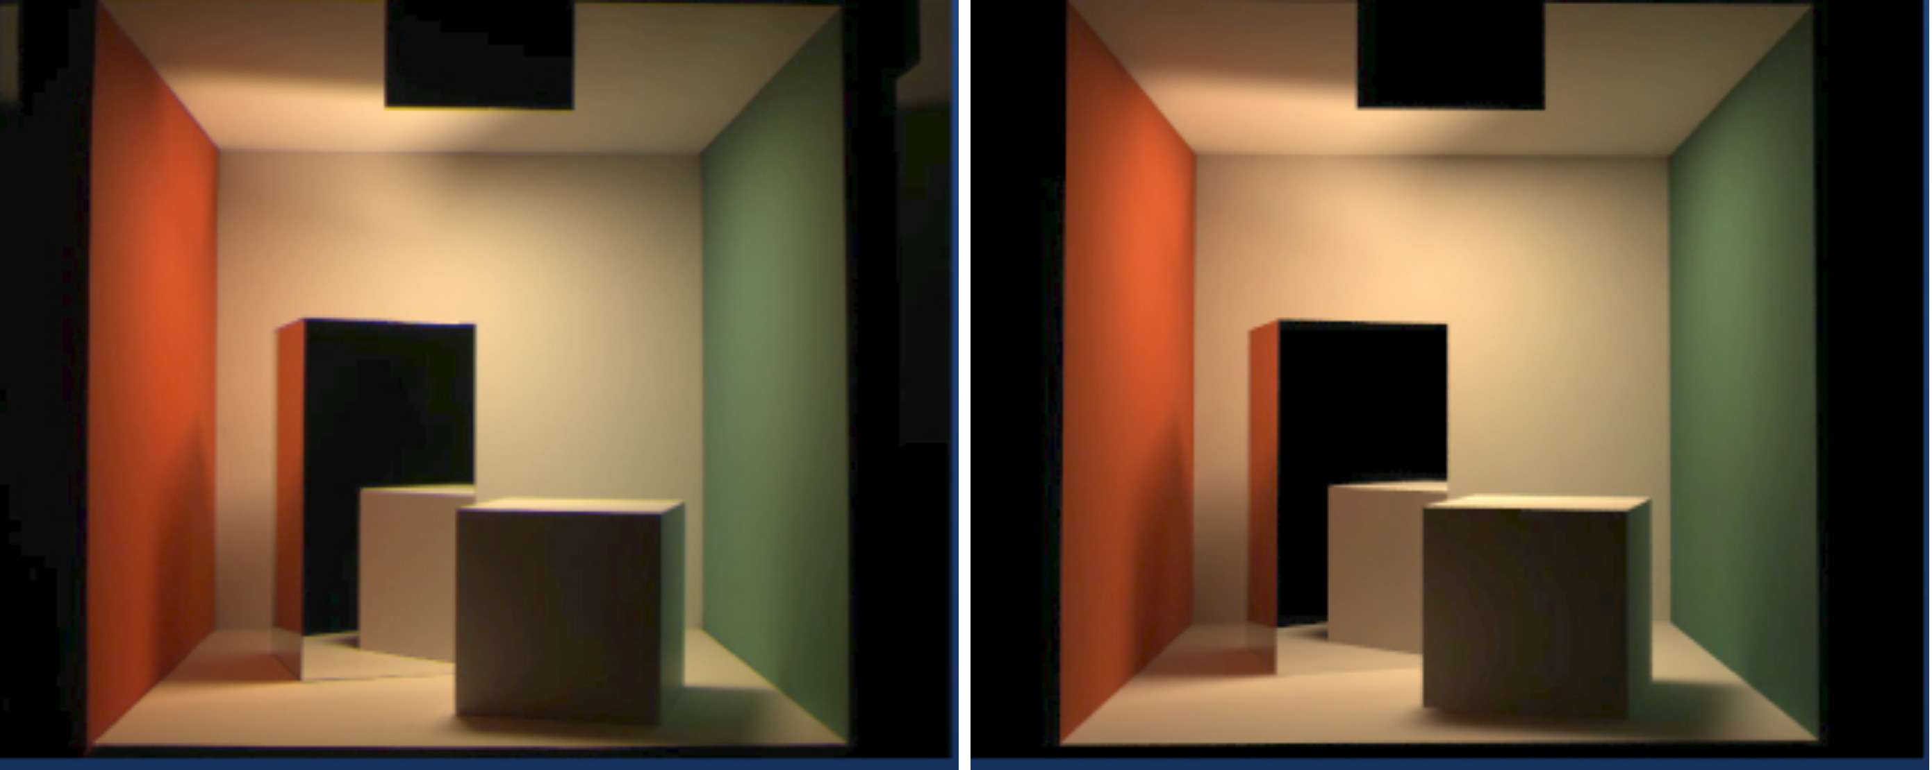
Vergleich Camera vs. Pbr
[3]

Slide 7
Reflectance equation

Slide 8
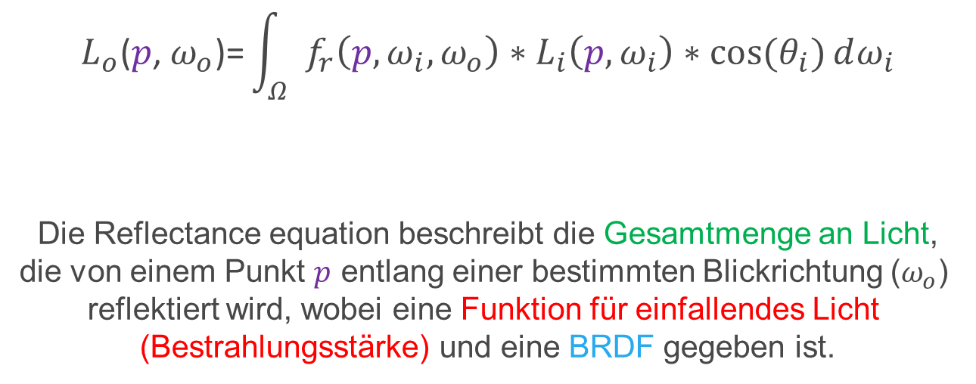
Reflectance equation
$$L_{o}\text{(}p\text{,} ω_{o}\text{)=}\int_{Ω}^{ }{ f_{r}\left(p,ω_{i},ω_{o}\right)∗L_{i}\left(p,ω_{i}\right)∗cos⁡(θ_{i})}ⅆω_{i}$$
Die Reflectance equation beschreibt die Gesamtmenge an Licht,
die von einem Punkt $p$ entlang einer bestimmten Blickrichtung ($ω_{o}$)
reflektiert wird, wobei eine Funktion für einfallendes Licht
(Bestrahlungsstärke) und eine BRDF gegeben ist.

Slide 9
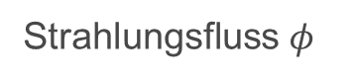
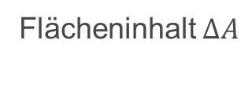
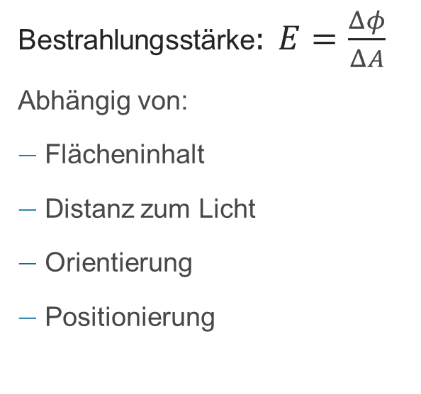
Bestrahlungsstärke
Bestrahlungsstärke$: E=\frac{Δφ}{ΔA}$
Abhängig von:
Flächeninhalt
Distanz zum Licht
Orientierung
Positionierung
Strahlungs­fluss$φ$
Flächeninhalt $ΔA$

Slide 10
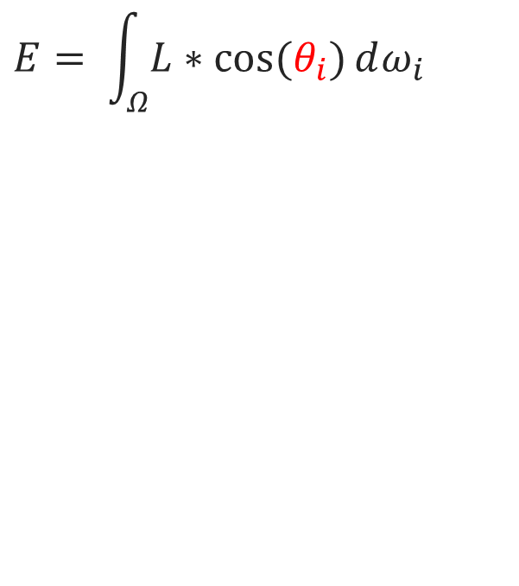
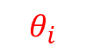
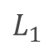
Bestrahlungsstärke
$$E= \int_{Ω}^{ }{L∗cos⁡(θ_{i})}ⅆω_{i}$$
$$L_{1}$$
n
$$θ_{i}$$
p

Slide 11
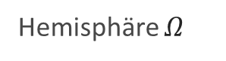
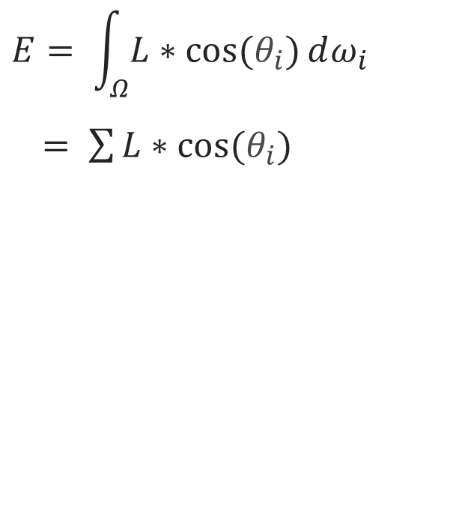
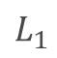
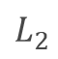
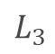
Bestrahlungsstärke
$$E= \int_{Ω}^{ }{L∗cos⁡(θ_{i})}ⅆω_{i}$$
$= \sum{L∗cos⁡(θ_{i})}$
$$L_{2}$$
$$L_{1}$$
$$L_{3}$$
Hemisphäre $Ω$
p

Slide 12
Reflectance equation
$$L_{o}\text{(}p\text{,} ω_{o}\text{)=}\int_{Ω}^{ }{ f_{r}\left(p,ω_{i},ω_{o}\right)∗L_{i}\left(p,ω_{i}\right)∗cos⁡(θ_{i})}ⅆω_{i}$$
Die Reflectance equation beschreibt die Gesamtmenge an Licht,
die von einem Punkt $p$ entlang einer bestimmten Blickrichtung ($ω_{o}$)
reflektiert wird, wobei eine Funktion für einfallendes Licht
(Bestrahlungsstärke) und eine BRDF gegeben ist.

Slide 13
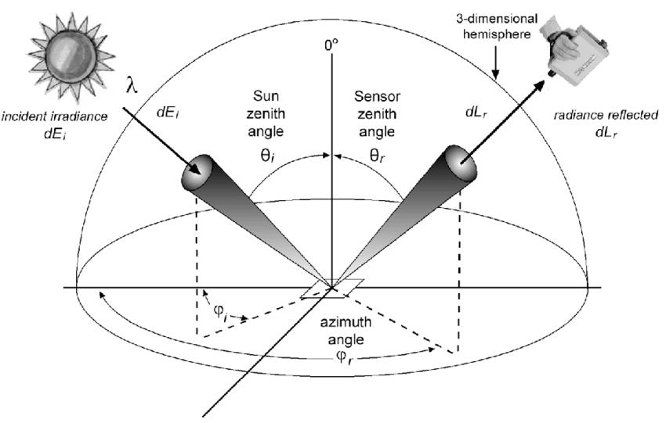
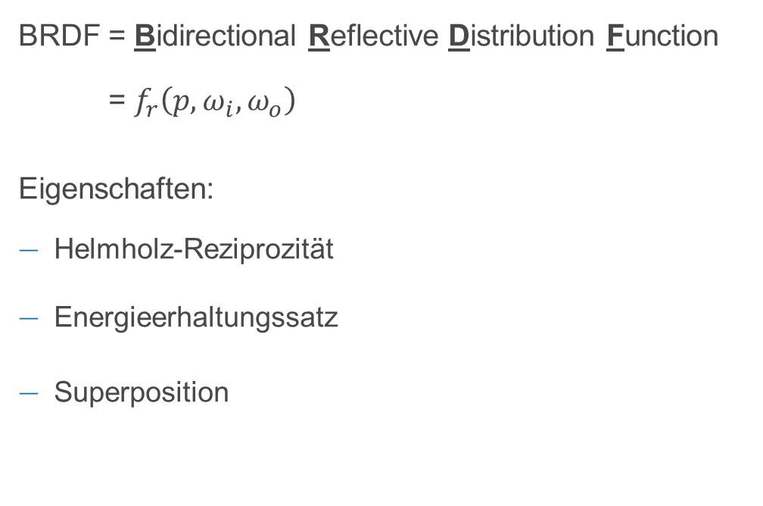
BRDF
BRDF = Bidirectional Reflective Distribution Function
= $f_{r}\left(p,ω_{i},ω_{o}\right)$
Eigenschaften:
Helmholz-Reziprozität
Energieerhaltungssatz
Superposition
[4]

Slide 14
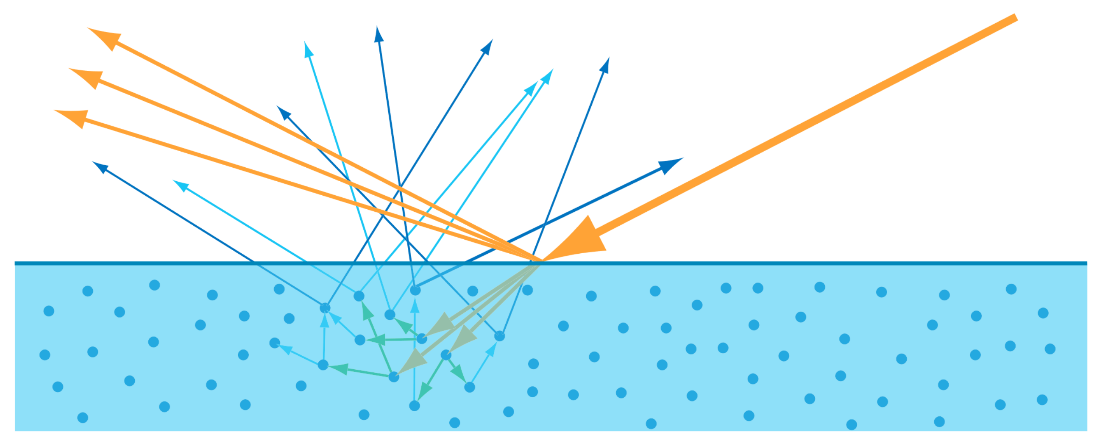
Material Eigenschaften
Nicht Metalle
Metalle
[6]

Slide 15
Material Eigenschaften
[6]

Slide 16
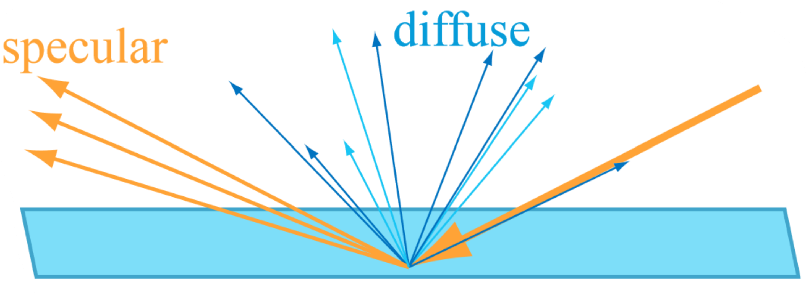
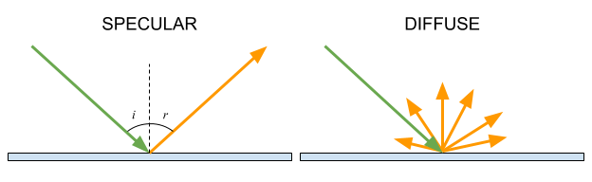
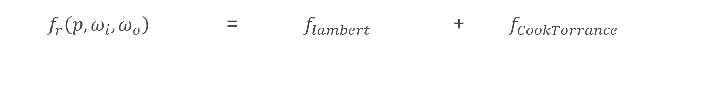
Specular und Diffuse
=
+
[5]
[5]
[6]
$f_{r}\left(p,ω_{i},ω_{o}\right)$ = $f_{lambert}$ + $f_{CookTorrance}$
≤ 1

Slide 17
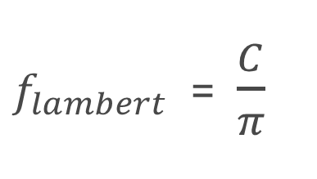
Lambert Diffuse
Oberflächenfarbe/Albedo
Lambert-Strahler
$f_{lambert}$ = $\frac{C}{π}$

Slide 18

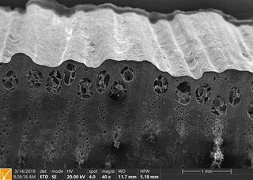
Microfacet Surface Model
[8]
[7]

Slide 19
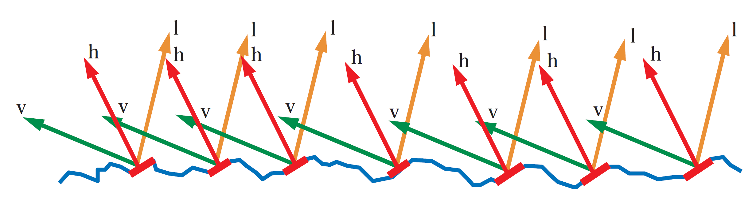
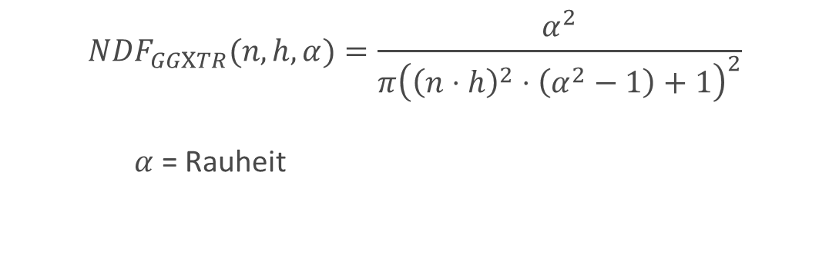
Normal Distribution Function
[6]
$$NDF_{GGXTR}(n,h,α)=\frac{α^{2}}{π{\left({\left(n⋅h\right)}^{2}⋅\left(α^{2}−1\right)+1\right)}^{2}}$$
$α$ = Rauheit

Slide 20
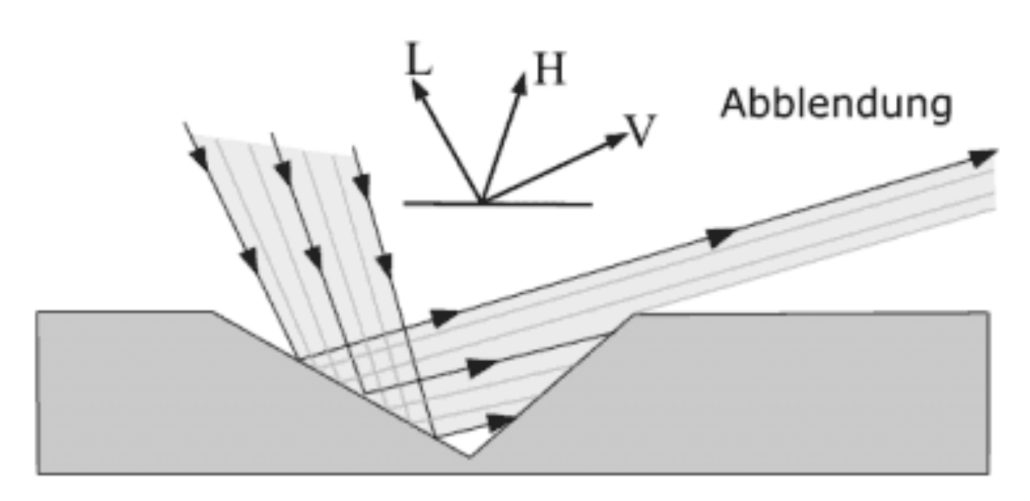
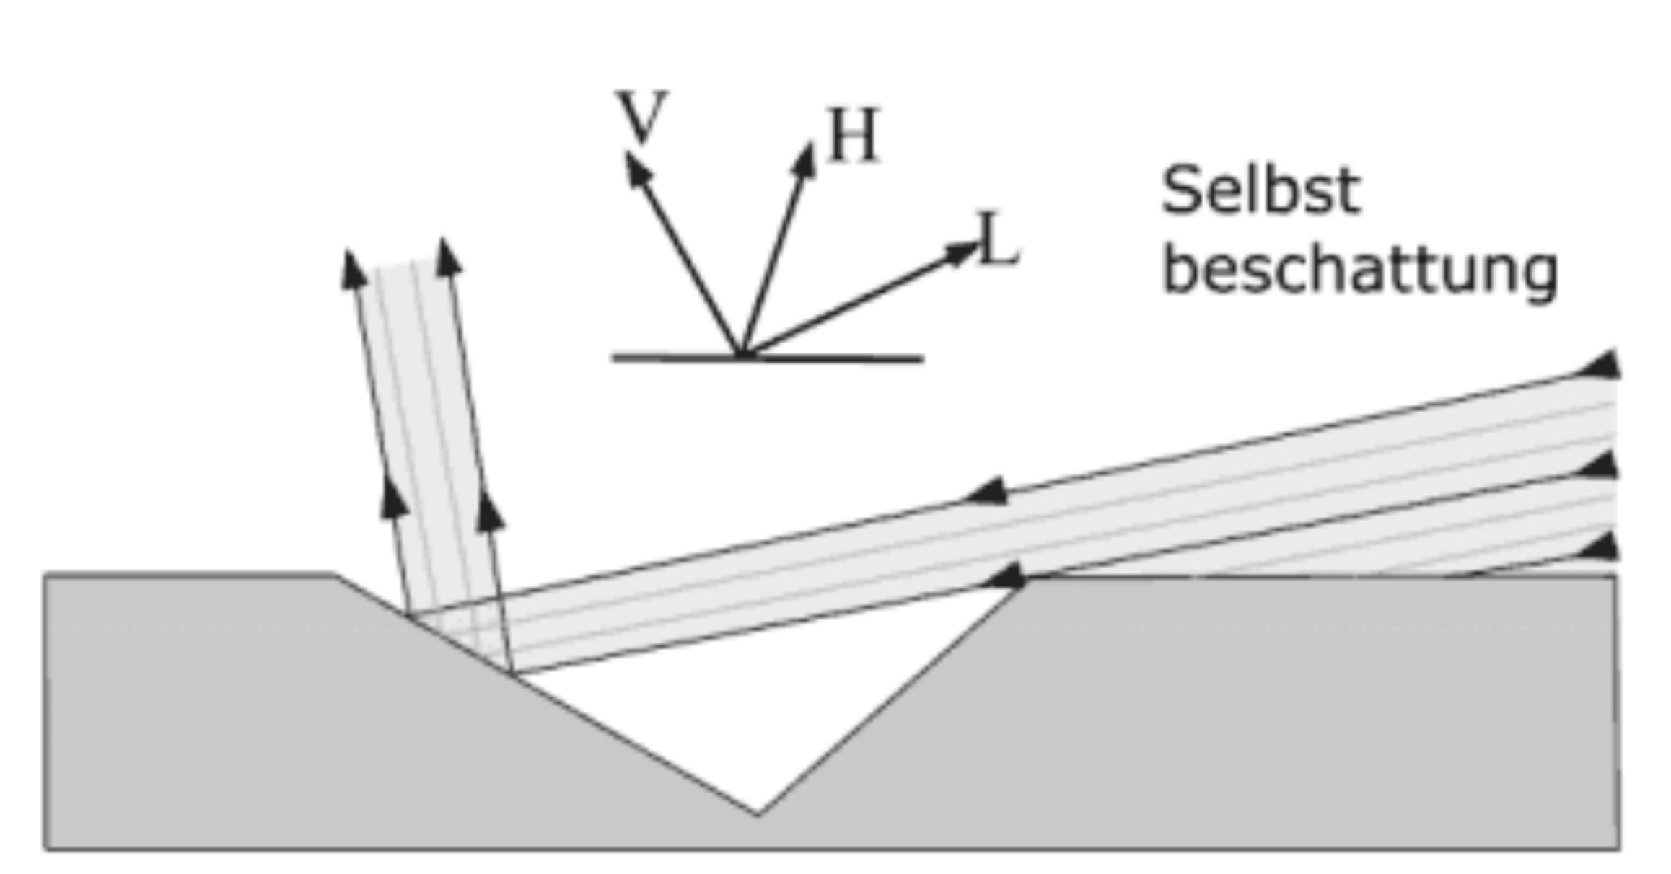
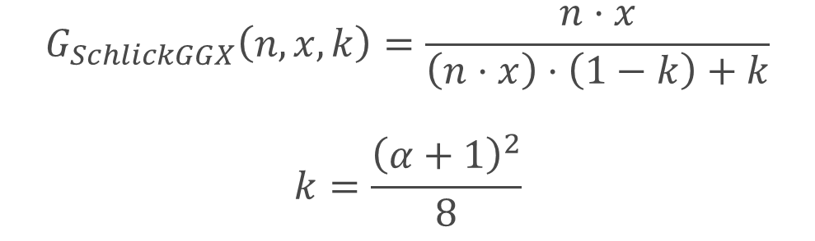
Geometry function
[9]
$$G_{SchlickGGX}\left(n,x,k\right)=\frac{n⋅x}{\left(n⋅x\right)⋅\left(1−k\right)+k}$$
$$k=\frac{{\left(α+1\right)}^{2}}{8}$$

Slide 21
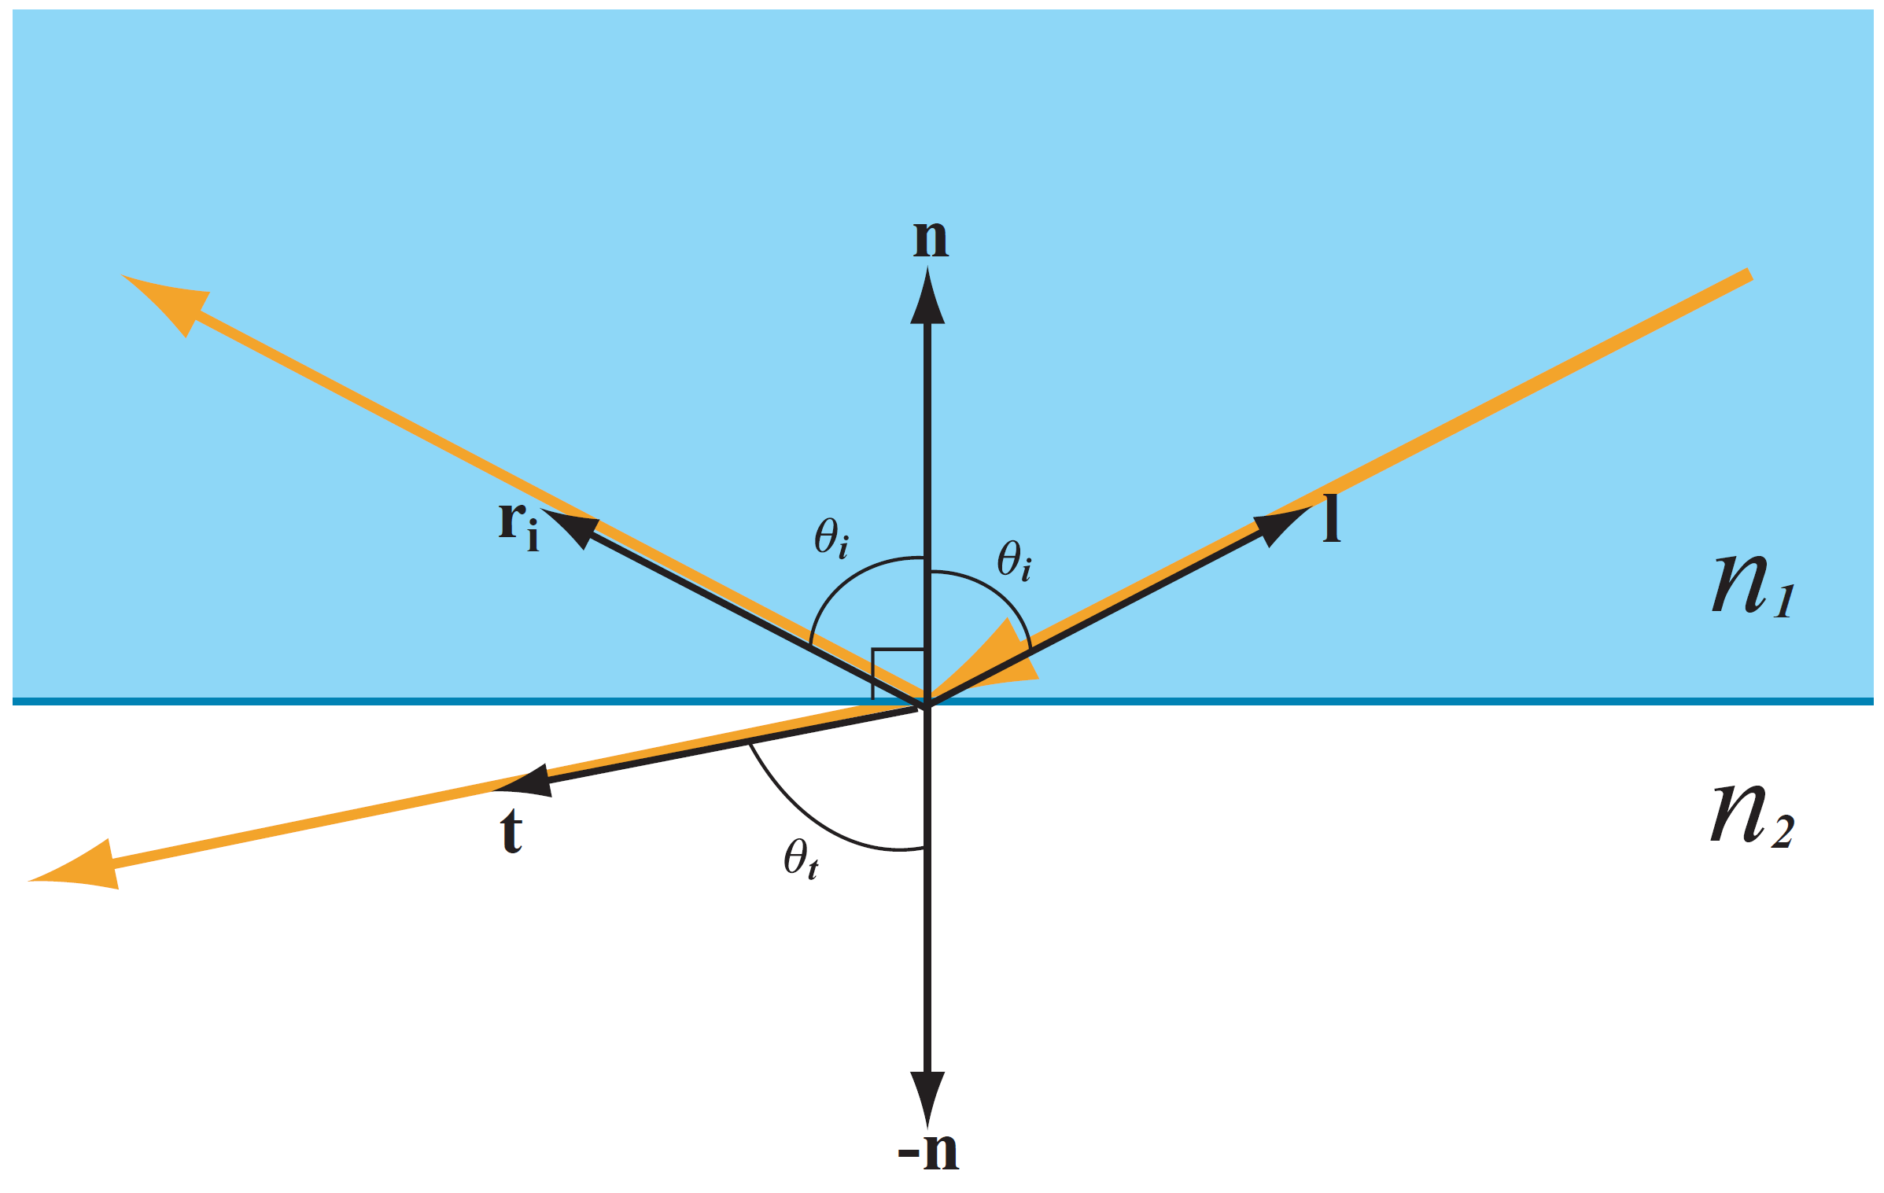
Fresnel equation
[6]

Slide 22

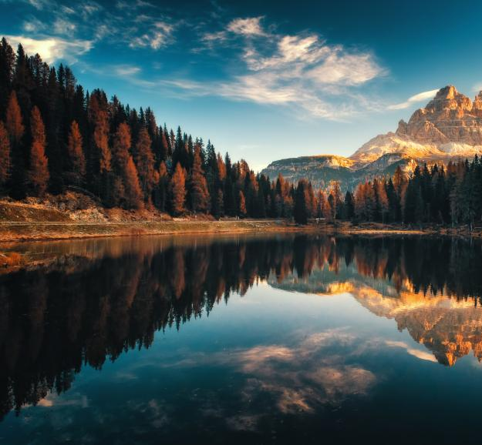
Fresnel equation
[10]
[11]

Slide 23
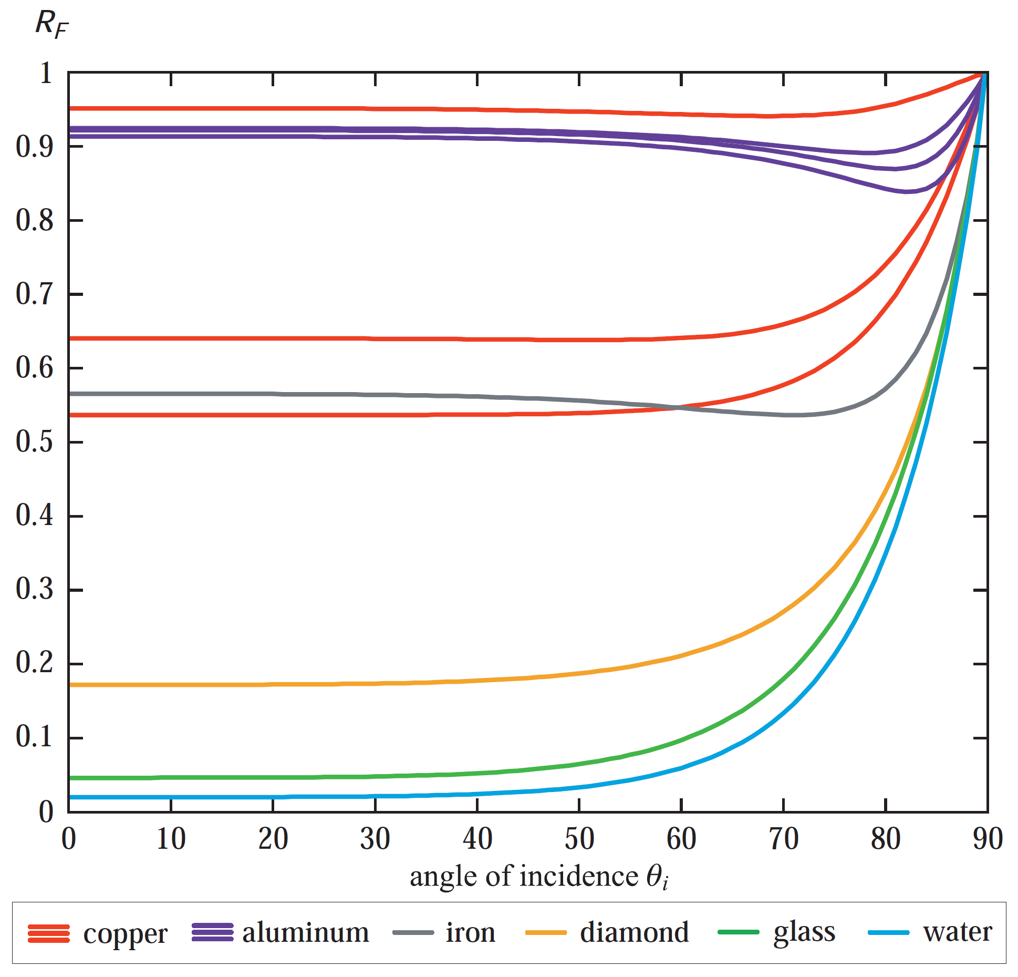

Fresnel equation
[7]
[6]

Slide 24
Fresnel equation
[7]
[6]

Slide 25
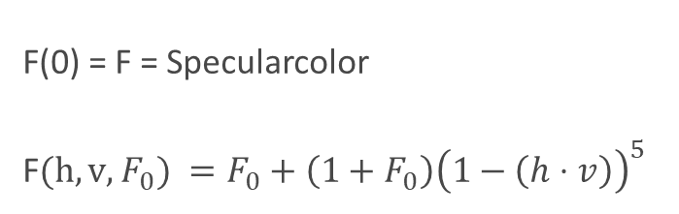
Fresnel equation
F(0) = F = Specularcolor
F$(h,v,F_{0}) =F_{0}+\left(1+F_{0}\right){\left(1−\left(h⋅v\right)\right)}^{5}$
[6]

Slide 26
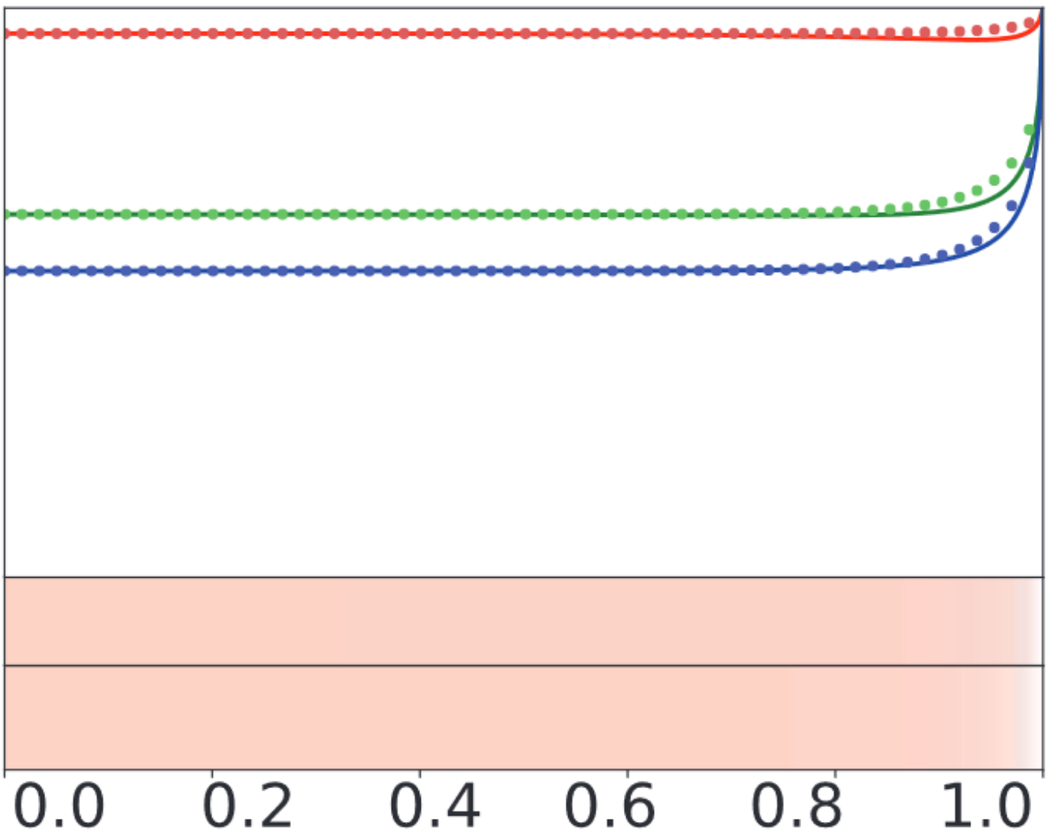
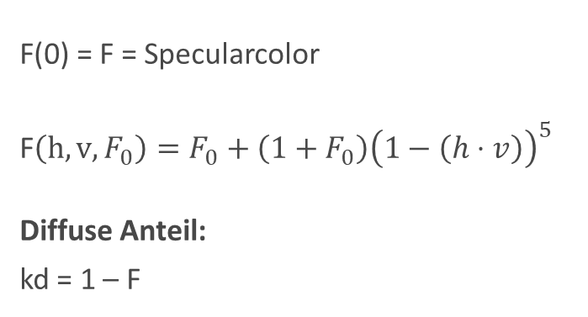
Fresnel equation
F(0) = F = Specularcolor
F$\left(h,v,F_{0}\right)=F_{0}+\left(1+F_{0}\right){\left(1−\left(h⋅v\right)\right)}^{5}$
Diffuse Anteil:
kd = 1 – F
[6]

Slide 27
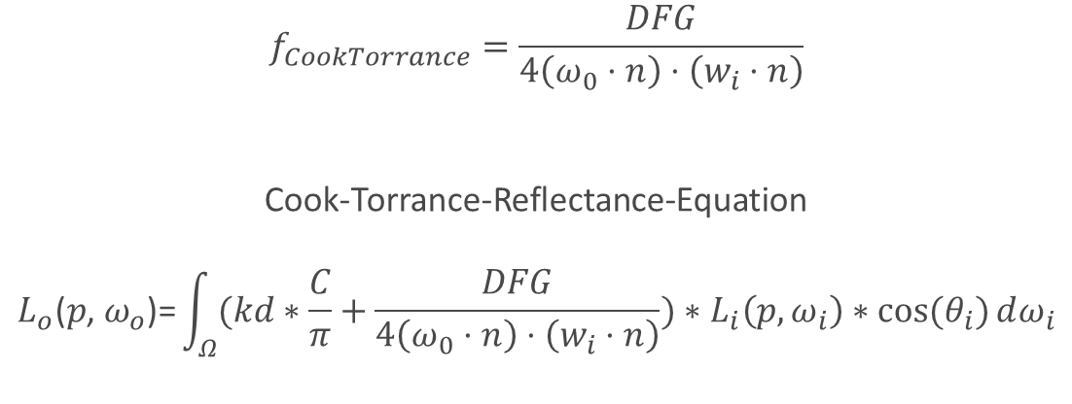
Cook-Torrance Specular
$$f_{CookTorrance}=\frac{DFG}{4\left(ω_{0}⋅n\right)⋅\left(w_{i}⋅n\right)}$$
Cook-Torrance-Reflectance-Equation
$$L_{o}\text{(}p\text{,} ω_{o}\text{)=}\int_{Ω}^{ }{(kd∗\frac{C}{π}+\frac{DFG}{4\left(ω_{0}⋅n\right)⋅\left(w_{i}⋅n\right)})∗L_{i}\left(p,ω_{i}\right)∗cos⁡(θ_{i})}ⅆω_{i}$$

Slide 28
Codebeispiel +
Live Demo

Slide 29
Zusammenfassung

Slide 30
Vorteile von Pbr-Beleuchtung
Berücksichtigt Physikalische Gegebenheiten
Vereinfachen die Einstellung der Parameter
=> Parameter müssen nicht optimiert werden, um ein realistisches Bild zu erzeugen.
Gleichmäßigeres Aussehen unter verschiedenen Beleuchtungsbedingungen
Liefert realistischere Ergebnisse
Erleichtert die Arbeit von Künstlern/Entwicklern

Slide 31
THANK YOU
QUESTIONS?

Slide 32
Quellen
https://cglearn.eu/pub/advanced-computer-graphics/physically-based-shading (14.11.2020)
http://1.bp.blogspot.com/-D5djI6sSxRc/VUkFgfTt5tI/AAAAAAAAAMY/hASrNNWypUU/s1600/comp.png (14.11.2020)
https://www.graphics.cornell.edu/online/box/compare.html (14.11.2020)
Schill, Steve & Jensen, John & Raber, George & Porter, Dwayne. (2004). “Temporal Modeling of Bidirectional Reflection Distribution Function (BRDF) in Coastal Vegetation”. GIScience & Remote Sensing
https://astrobites.org/wp-content/uploads/2020/09/reflection.png (14.11.2020)
Akenine-Mller, Tomas and Haines, Eric and Hoffman, Naty. (2018). “Real-Time Rendering, Fourth Edition“. A. K. Peters, Ltd.
https://learnopengl.com/PBR/Theory (14.11.2020)
https://www.farbeundlack.de/var/ezflow_site/storage/images/media/images/lodb_schraegquerschnittweakspotx40/26016478-1-ger-DE/LODB_schraegQuerschnittWeakSpotx40_articleimage.jpg (14.11.2020)
http://www.irrlicht3d.org/papers/BrdfModelle.pdf (14.11.2020)
https://www.br.de/kinder/wasser-schwimmbad-licht-100~_v-img__16__9__m_-4423061158a17f4152aef84861ed0243214ae6e7.jpg?version=709fd (14.11.2020)
https://www.digitalphoto.de/media/digitalphoto/styles/tec_frontend_large/public/images/2017/12/image-330272--758561.jpeg?itok=N8RANku1 (14.11.2020)

Slide 33
“
EVERYTHING IS DESIGNED. FEW THINGS ARE DESIGNED WELL.
- BRIAN REED

Slide 34
UNORDERED LIST
Muffin marshmallow ice cream. Macaroon lemon drops dessert biscuit. Jelly-o candy canes bear claw cheesecake icing powder pastry pudding.
Cake apple pie bonbon jelly-o cake. Cake pudding ice cream cake dessert chocolate cake chocolate. Chocolate tootsie roll cake marshmallow
Jujubes sweet roll jelly-o chocolate bar wafer soufflé donut gingerbread sesame snaps. Apple pie cookie toffee tart powder sweet bonbon
Jujubes sweet roll gummies liquorice jelly beans cake jujubes lemon drops. Danish dessert bonbon macaroon. Cupcake soufflé wafer
Sesame snaps jelly dessert tootsie roll sweet roll candy canes. Sesame snaps sweet roll jujubes cheesecake marzipan. Toffee fruitcake chocolate cake.
Muffin marshmallow ice cream. Macaroon lemon drops dessert biscuit. Jelly-o candy canes bear claw cheesecake icing powder pastry pudding.
Cake apple pie bonbon jelly-o cake. Cake pudding ice cream cake dessert chocolate cake chocolate. Chocolate tootsie roll cake marshmallow

Slide 35
BASIC CONTENT
COPY, LISTS, IMAGES

Slide 36
ORDERED LIST
Sesame snaps jelly dessert tootsie roll sweet roll candy canes. Sesame snaps sweet roll jujubes cheesecake marzipan. Toffee fruitcake chocolate cake.
Muffin marshmallow ice cream. Macaroon lemon drops dessert biscuit. Jelly-o candy canes bear claw cheesecake icing powder pastry pudding.
Cake apple pie bonbon jelly-o cake. Cake pudding ice cream cake dessert chocolate cake chocolate. Chocolate tootsie roll cake marshmallow
Jujubes sweet roll jelly-o chocolate bar wafer soufflé donut gingerbread sesame snaps. Apple pie cookie toffee tart powder sweet bonbon
Jujubes sweet roll gummies liquorice jelly beans cake jujubes lemon drops. Danish dessert bonbon macaroon. Cupcake soufflé wafer
Sesame snaps jelly dessert tootsie roll sweet roll candy canes. Sesame snaps sweet roll jujubes cheesecake marzipan. Toffee fruitcake chocolate cake.
Muffin marshmallow ice cream. Macaroon lemon drops dessert biscuit. Jelly-o candy canes bear claw cheesecake icing powder pastry pudding.
Cake apple pie bonbon jelly-o cake. Cake pudding ice cream cake dessert chocolate cake chocolate. Chocolate tootsie roll cake marshmallow
Jujubes sweet roll jelly-o chocolate bar wafer soufflé donut gingerbread sesame snaps. Apple pie cookie toffee tart powder sweet bonbon
Jujubes sweet roll gummies liquorice jelly beans cake jujubes lemon drops. Danish dessert bonbon macaroon. Cupcake soufflé wafer

Slide 37
TIMELINES
AGENDA, COMPANY, HISTORY, MILESTONES

Slide 38
BEST TIMELINE HORZ
1
2
3
4
5
NEW EVENT
NEW EVENT
NEW EVENT
NEW EVENT
NEW EVENT
Dessert tiramisu sweet cotton candy bear
Dessert tiramisu sweet cotton candy bear
Dessert tiramisu sweet cotton candy bear
Dessert tiramisu sweet cotton candy bear
Dessert tiramisu sweet cotton candy bear

Slide 39
PYRAMID CHARTS
LAYERS, STRUCTURE

Slide 40
PYRAMID 01
TREE SERVICE ONE
TREE SERVICE ONE
Dessert tiramisu sweet cotton
Dessert tiramisu sweet cotton
TREE SERVICE ONE
TREE SERVICE ONE
Dessert tiramisu sweet cotton
Dessert tiramisu sweet cotton
TREE SERVICE ONE
TREE SERVICE ONE
Dessert tiramisu sweet cotton
Dessert tiramisu sweet cotton
TREE SERVICE ONE
TREE SERVICE ONE
Dessert tiramisu sweet cotton
Dessert tiramisu sweet cotton

Slide 41
PYRAMID 03
TREE SERVICE ONE
TOP
Dessert tiramisu sweet cotton
SERVICE
TREE SERVICE ONE
Dessert tiramisu
Dessert tiramisu sweet cotton
TREE SERVICE ONE
TREE SERVICE ONE
Dessert tiramisu sweet cotton
Dessert tiramisu sweet cotton
TREE SERVICE ONE
TREE SERVICE ONE
Dessert tiramisu sweet cotton
Dessert tiramisu sweet cotton
TREE SERVICE ONE
TREE SERVICE ONE
Dessert tiramisu sweet cotton
Dessert tiramisu sweet cotton

Slide 42
PYRAMID 06
SERVICE
Dessert
TREE SERVICE ONE
Dessert tiramisu
TREE SERVICE ONE GOES
Dessert tiramisu sweet cotton
TREE SERVICE ONE GOES HERE
Dessert tiramisu sweet cotton
TREE SERVICE ONE GOES HERE AND
Dessert tiramisu sweet cotton
TREE SERVICE ONE GOES HERE AND HERE
Dessert tiramisu sweet cotton

